Slide 1


SAP UI5 & FIORI with OData TRAINING
Anubhav Oberoy & Nishan Nainsukha
Day – 18

Slide 2

Agenda – Day 18
Getting Detail Screen data
Performing Post From UI
Performing GET(Single) From UI
Performing Delete From UI
Function Import
Trainer: Anubhav Oberoy & Nishan

Slide 3

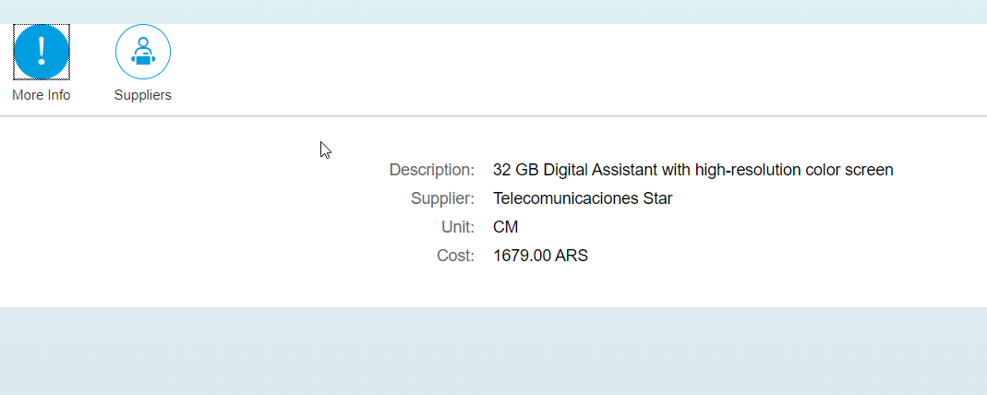
Getting Detail Screen data
Step1: Changing the View2 controller Code.
Step 2: View2 code.
Step 3: Fragment code.(supplier , moreInfo)

Slide 4

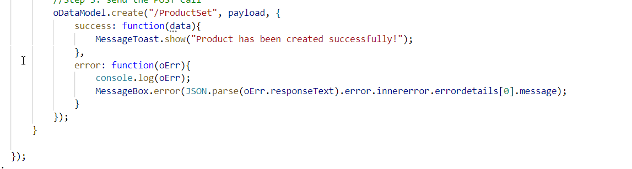
Performing Post From UI
Step1: Create Add Screen for User.
Step2: Create Add Controller .
Step3: Creating Footer on View1 Screen With Add Button.
Step4: Creating Entry for Add View in manifest.json .
Step5: Write add button logic in View1 Controller .

Slide 5
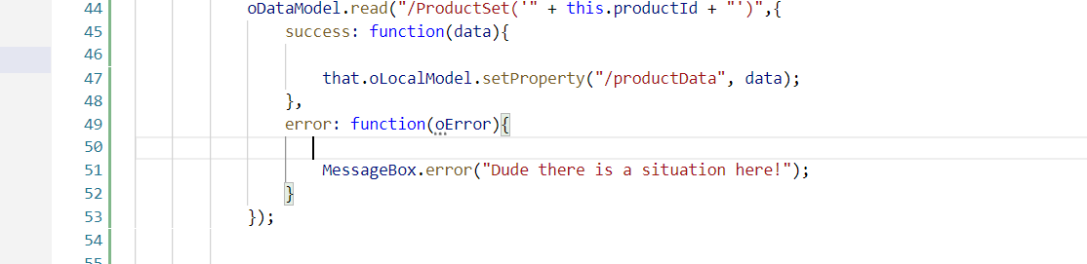
Performing GET(Single) From UI
Step1: Add change event in the Id Filed of Add Screen
Step2: When we put ID in that field it should load that entry.
Step3: Add OnLoad Function in Add Controller

Slide 6
Performing Delete From UI
Step1: Add Delete button on Add Screen footer
Step2: When we click the button it should delete that entry.
Step3: Add OnLoad Function in Add Controller

Slide 7
Function Import
Calling the Function Import From UI
Step1: Add a button on Add Screen which calls the function import.
Step2: add the button press logic in Add Controller
var oDataModel = this.getView().getModel();
var that = this;
oDataModel.callFunction("/GetMostExpensiveProduct",{
urlParameters: {
"I_CATEGORY": 'Notebooks'
},
success: function(data){
},
error: function(oError){
}
});

Slide 8

End of Day 18

Slide 9

Questions

Slide 10

Anubhav Oberoy

Slide 11


We’re committed to empower you to be
Most Desirable Resource
through powerful training solutions.
We build the workforce of the future.
250+
Corporate Clients
30,000+
Learners Trained
25000+
Learners Placed
FREE WEBINARS
Sign up for free webinars with industry experts every fortnight!
Enroll Now!
Contact us today!
https://anubhavtrainings.com/

Slide 12




More from AnubhavTrainings.com

